Slide 1

Crime Rates & Literacy Level in Global Trends : A Statistical Analysis
Presented by:
SATYA PRAKASH SAMAL (23CSEDS019)
SWAPNAJIT BARIK (23CSEDS030)
CHANDAN DAS (23CSEDS017)
Guided by:
Mr. Sujit Kumar Patro
Assistant Professor
Department of Computer Science & Engineering

Slide 2
CONTENT
INTRODUCTION
BASIC CONCEPTS USED
TOOLS & TECHNOLOGIES USED
PROJECT DEVELOPMENT PROCESS
RESULTS & OUTPUT
LEARING & KEY TAKEWAYS
FUTURE SCOPE & IMPROVEMENTS
CONCLUSION
REFERENCES & ACKNOWLEDGMENTS

Slide 3
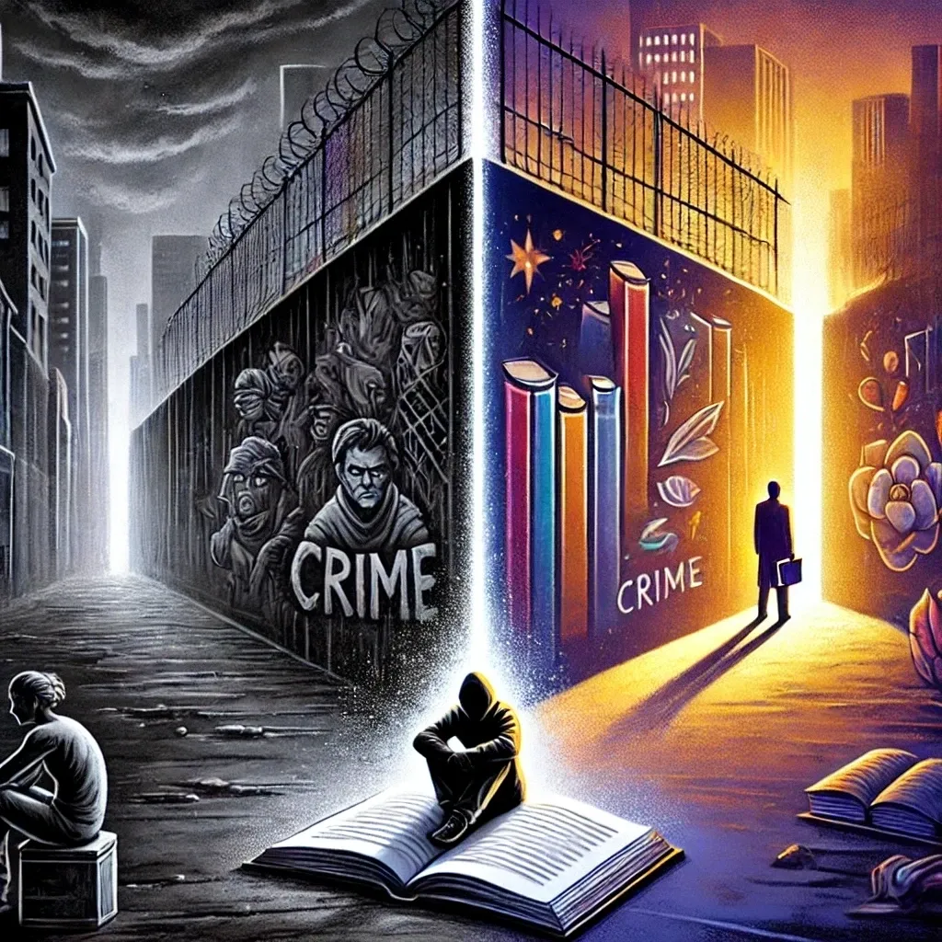
INTRODUCTION
This Project aims to analyze & understand the relationship between Crime Rates and Literacy levels across various countries over multiple decades.
By exploring these two crucial socio-economic indicators, the study seeks to uncover patterns, correlations and key determinants that link education levels to criminal activity.
The main idea behind building this project is , after looking into the surge in few categories of crime(such as Cyber Crime, Money Laundering, Crime against Women) whereas the literacy rate increasing which seems contradictory…..

Slide 4
BASIC CONCEPTS USED
✅ Data Merging: Combining datasets ✅ Correlation Analysis: Checking if literacy rate impacts crime rate (positive/negative correlation) ✅ Regression Analysis: Predicting crime trends based on literacy rates ✅ Data Visualization: Graphs to compare crime and literacy trends ✅ Handling Missing Data: Dropping or filling missing values

Slide 5
Tools & Technologies Used
🛠 Software / Programming Languages / Platforms
Python 🐍
Jupyter Notebook 📒
Pandas & NumPy 📊
Matplotlib & Seaborn 📉
Plotly 📊✨
🔹Role of Each Tool in the Project
Python → Core programming language for data analysis
Jupyter Notebook → Running code, visualizing results in an interactive way
Pandas & NumPy → Merging datasets, handling missing values, calculating statistics
Matplotlib & Seaborn → Creating graphs like scatter plots, heatmaps, and trend charts
Plotly → Creating interactive charts to explore crime & literacy rate relationships dynamically

Slide 6
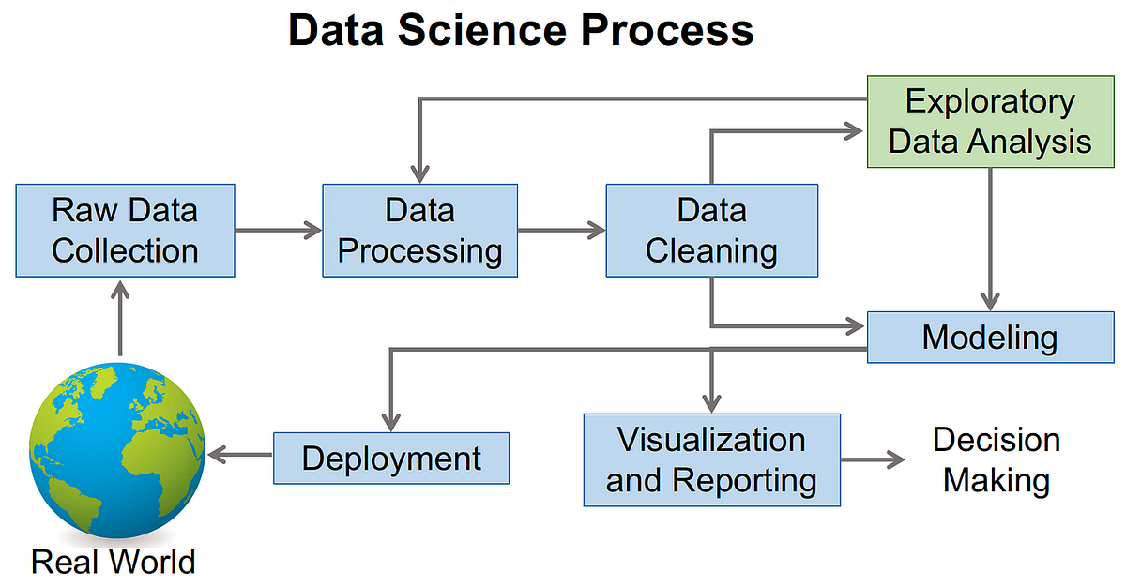
Project Development Process

Slide 7
Challenges
As Currently our projects are in Foundational stage , the biggest challenge for us so far has been data.
Lack of Data Availability
Available Data are not sufficient
Lot of anomalies in the dataset
Lack of desired features / attributes
Data Merging

Slide 8
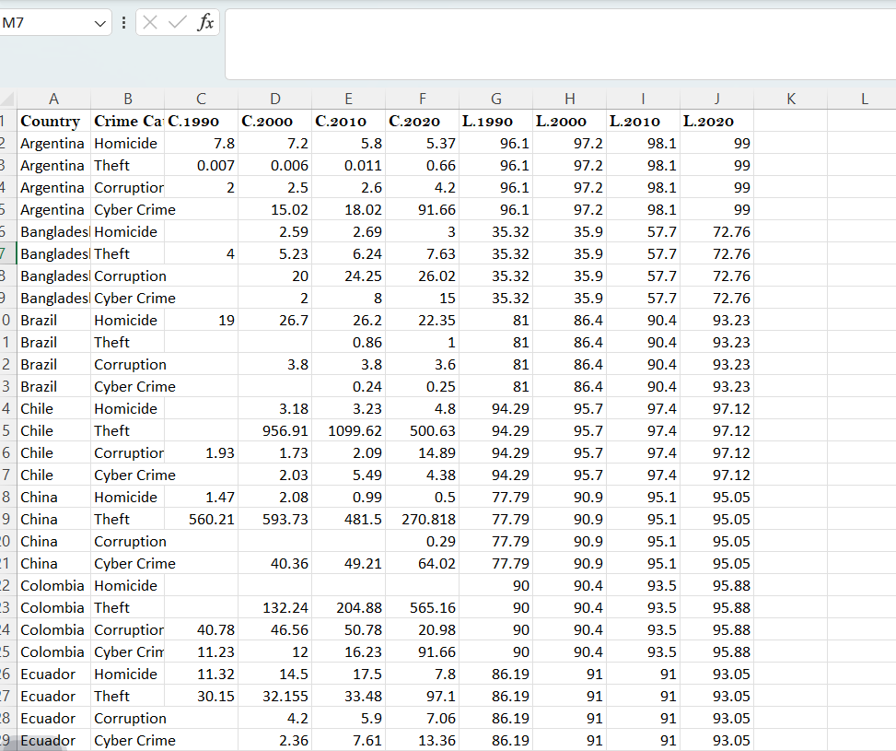
INITIAL DATASET
Crime Categories
Crime Rate(per 100000) in 1990
Literacy Rate in 1990

Slide 9
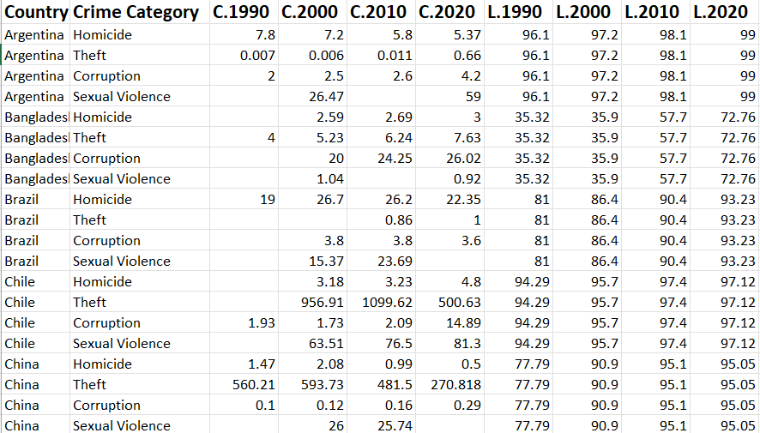
Modified Dataset
REPLACED CYBER CRIME

Slide 10
We have the data of 38 Countries Globally.
The selection of countries was done based on High income , Middle income , low income & island countries.
There are 4 Crime Categories
I. Homicide
ii.Corruption
iii.Theft
iv.Sexual Violence
We have collected the data of crime rate & literacy rate with a interval of 10 years from (1990-2020) because these are not one of the high frequency indicators.

Slide 12
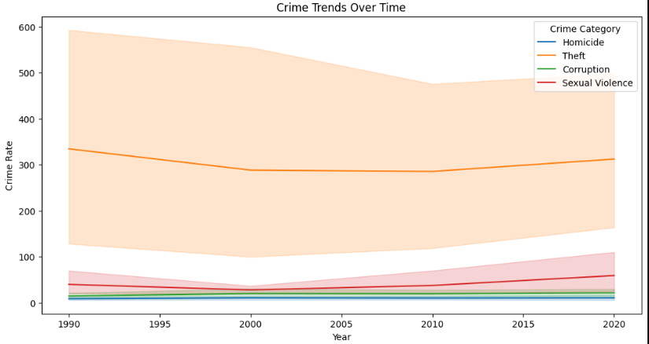
RESULTS & OUTCOMES

Slide 13
INSIGHTS
📉 Theft Dominates but Declines – Theft has the highest crime rate but showed a decline until 2005 before stabilizing.
📈 Rising Sexual Violence – Cases have increased significantly since 2000, indicating a concerning trend.
⚖️ Homicide & Corruption Stay Low – These crimes remain relatively stable with minimal fluctuations.
🔄 2000 Dip in Crime Rates – A noticeable drop in most crimes around 2000 suggests possible policy shifts or law enforcement improvements.

Slide 14
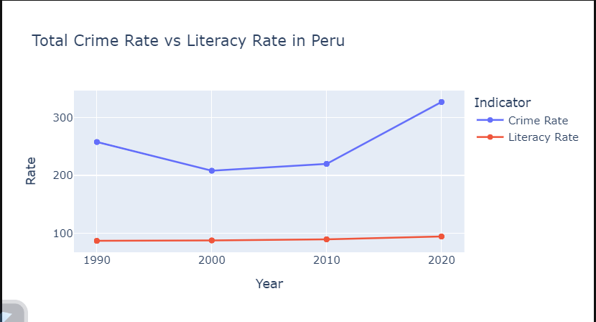
Impact of Literacy Rate on Crime Rate in Peru

Slide 15
INSIGHTS
Crime Rate Fluctuation 📉📈: The crime rate in Peru declined from 1990 to 2000 but started rising again, peaking sharply in 2020.
Literacy Rate Stability 📊:Literacy rate remained consistently high with only a slight increase over time.
No Direct Impact? 🤔:Despite a rising literacy rate, crime rates increased after 2000, suggesting other socio-economic factors might be influencing crime trends.
Upward Trend Crime Rate 📈: There’s a sharp 48% increase in crime rate from 2010-2020.

Slide 16
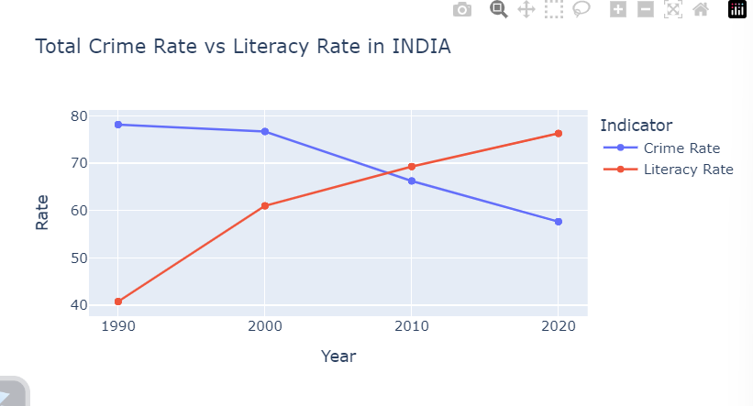
Crime Rate Vs Literacy Rate

Slide 17
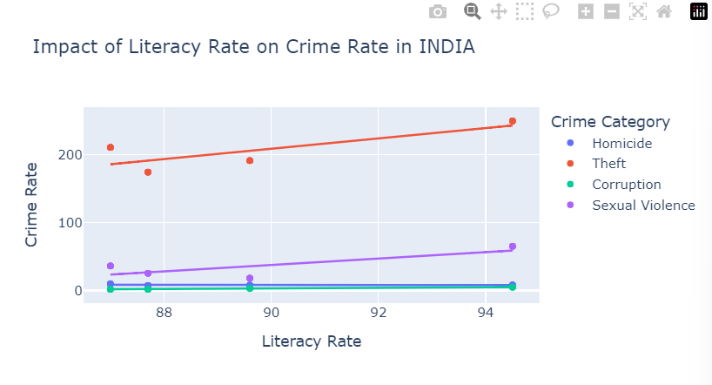

Slide 18
INSIGHTS
📚 Rising Literacy Rate: India's literacy rate has consistently increased from 1990 to 2020.
🚔 Declining Crime Rate: The crime rate has steadily decreased over the years.
🔄 Inverse Relationship?:As literacy improved, crime rates dropped, suggesting a potential link between education and reduced crime.
📈 Theft Increases with Literacy: Unlike expectations, theft cases show a rising trend with increasing literacy rates.
🟣 Sexual Violence Also Rising: A gradual increase in sexual violence cases is observed despite rising literacy.
🔵 Homicide is Stable: No significant increase or decrease in homicide cases as literacy improves.

Slide 19
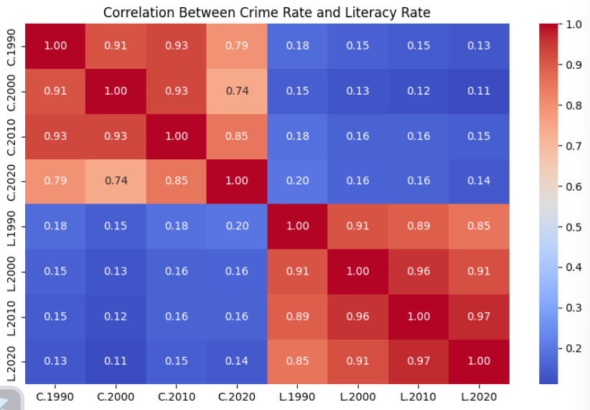
HEAT MAP ANALYSIS

Slide 20
INSIGHTS
🔹 Crime rates are strongly correlated over decades (e.g., C.1990 & C.2000: 0.91) → Crime trends persist over time.
🔹 Literacy rates show steady growth (e.g., L.2010 & L.2020: 0.97) → Education consistently improves.
🔹 Crime & literacy have weak correlation (~0.1-0.2) → Higher literacy doesn’t strongly impact crime globally.
🔹 The weak correlation between literacy and crime suggests other socio-economic factors (e.g., poverty, unemployment, policies) may play a bigger role in crime reduction than just literacy alone.

Slide 21
FUTURE OBJECTIVES
We have plans to build a regression model (country specific) which will predict both Literacy rate & Crime Rate.
We have start working to build a website , where we have plans to show up all the statistics & Insights

Slide 22
Conclusion
In this project, we aimed to analyze the relationship between crime rates and literacy rates across various countries over multiple decades. As of now, we have primarily focused on data cleaning and preprocessing, ensuring that our dataset is well-structured, accurate, and ready for further analysis. With a cleaned and structured dataset, we are now well-prepared to move forward with exploratory data analysis (EDA), statistical correlations, and visualizations to uncover insights into how literacy rates may influence crime patterns worldwide.

Slide 23
References & Acknowledgments
University of Shanghai for Science and Technology(Identification of Regression Model for Crime Rate and Literacy Rate in India).
UN(United Nations)
World Bank

Slide 24
THANK YOU!!!

